Slide 1
RNN & LSTM
Ehtisham Ur Rehman
ehtishamrehman@uetpeshawar.edu.pk

Slide 2
Contents
What is Neural Network?
About Recurrent Neural Network (RNN)?
Why Recurrent Neural Networks?
How Does Recurrent Neural Networks Work?
Applications
LSTM (Long Short Memory Term Memory)
Implementation using Python.

Slide 3
What Is a Neural Network?
A Neural Network consists of different layers connected to each other, working on the structure and function of a human brain. It learns from huge volumes of data and uses complex algorithms to train a neural net.
Here is an example of how neural networks can identify a dog’s breed based on their features.
The image pixels of two different breeds of dogs are fed to the input layer of the neural network.
The image pixels are then processed in the hidden layers for feature extraction.
The output layer produces the result to identify if it’s a German Shepherd or a Labrador.
Such networks do not require memorizing the past output

Slide 4
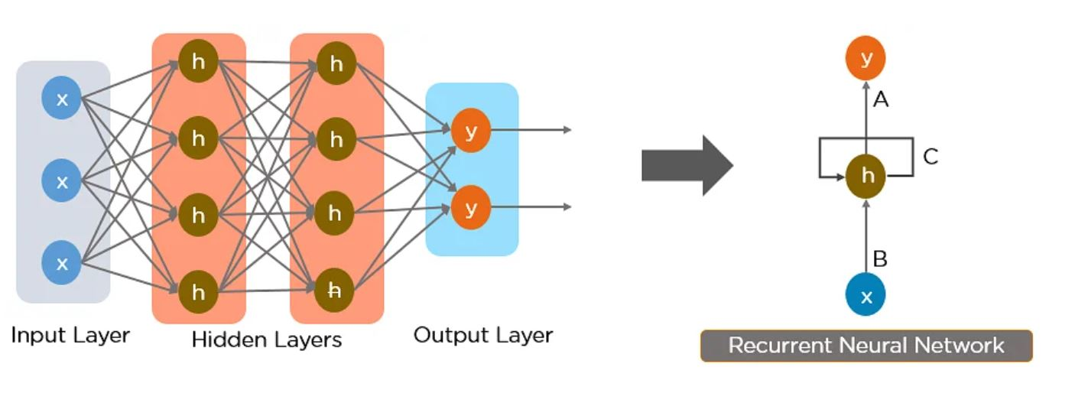
About Recurrent Neural Network (RNN)?
RNN works on the principle of saving the output of a particular layer and feeding this back to the input in order to predict the output of the layer.
Notes:
Below is how you can convert a Feed-Forward Neural Network into a Recurrent Neural Network.
In a recurrent neural network we store the output activations from one or more of the layers of the network. Often these are hidden later activations. Then, the next time we feed an input example to the network, we include the previously-stored outputs as additional inputs. You can think of the additional inputs as being concatenated to the end of the “normal” inputs to the previous layer. For example, if a hidden layer had 10 regular input nodes and 128 hidden nodes in the layer, then it would actually have 138 total inputs (assuming you are feeding the layer’s outputs into itself à la Elman) rather than into another layer). Of course, the very first time you try to compute the output of the network you’ll need to fill in those extra 128 inputs with 0s or something

Slide 5
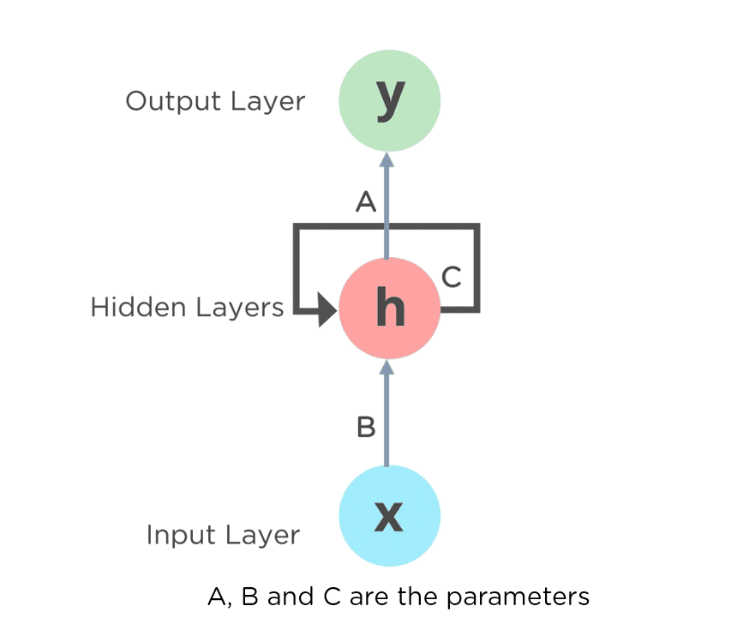
The nodes in different layers of the neural network are compressed to form a single layer of recurrent neural networks. A, B, and C are the parameters of the network.
Notes:
The parameters of a neural network are typically the weights of the connections. The hyper parameters are typically the learning rate, the batch size or the number of epochs.

Slide 6
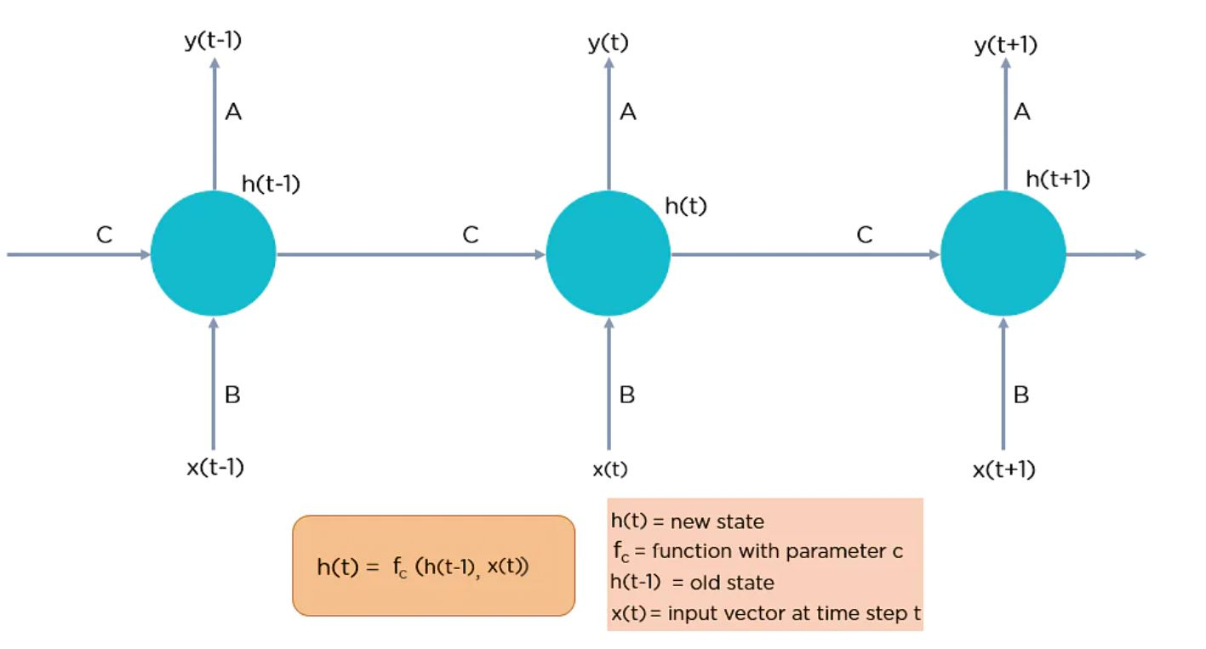
Here, “x” is the input layer, “h” is the hidden layer, and “y” is the output layer. A, B, and C are the network parameters used to improve the output of the model. At any given time t, the current input is a combination of input at x(t) and x(t-1). The output at any given time is fetched back to the network to improve on the output

Slide 7
Why Recurrent Neural Networks?
RNN were created because there were a few issues in the feed-forward neural network:
Cannot handle sequential data
Considers only the current input
Cannot memorize previous inputs
The solution to these issues is the RNN. An RNN can handle sequential data, accepting the current input data, and previously received inputs. RNNs can memorize previous inputs due to their internal memory.

Slide 8

How Does Recurrent Neural Networks Work?
Notes:
In Recurrent Neural networks, the information cycles through a loop to the middle hidden layer.
The input layer ‘x’ takes in the input to the neural network and processes it and passes it onto the middle layer.
The middle layer ‘h’ can consist of multiple hidden layers, each with its own activation functions and weights and biases. If you have a neural network where the various parameters of different hidden layers are not affected by the previous layer, ie: the neural network does not have memory, then you can use a recurrent neural network.
The Recurrent Neural Network will standardize the different activation functions and weights and biases so that each hidden layer has the same parameters. Then, instead of creating multiple hidden layers, it will create one and loop over it as many times as required.

Slide 9
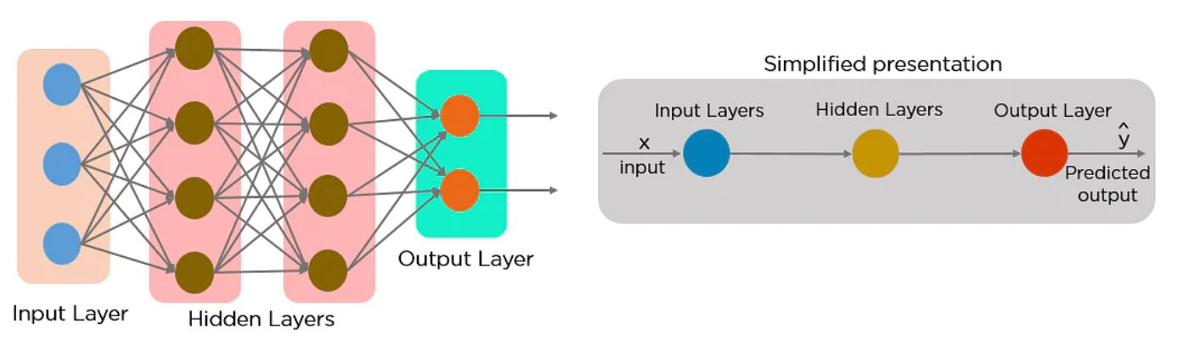
Feed-Forward Neural Networks vs Recurrent Neural Networks
A feed-forward neural network allows information to flow only in the forward direction, from the input nodes, through the hidden layers, and to the output nodes. There are no cycles or loops in the network.
Below is how a simplified presentation of a feed-forward neural network looks like:
Notes:
In a feed-forward neural network, the decisions are based on the current input. It doesn’t memorize the past data, and there’s no future scope. Feed-forward neural networks are used in general regression and classification problems.

Slide 10
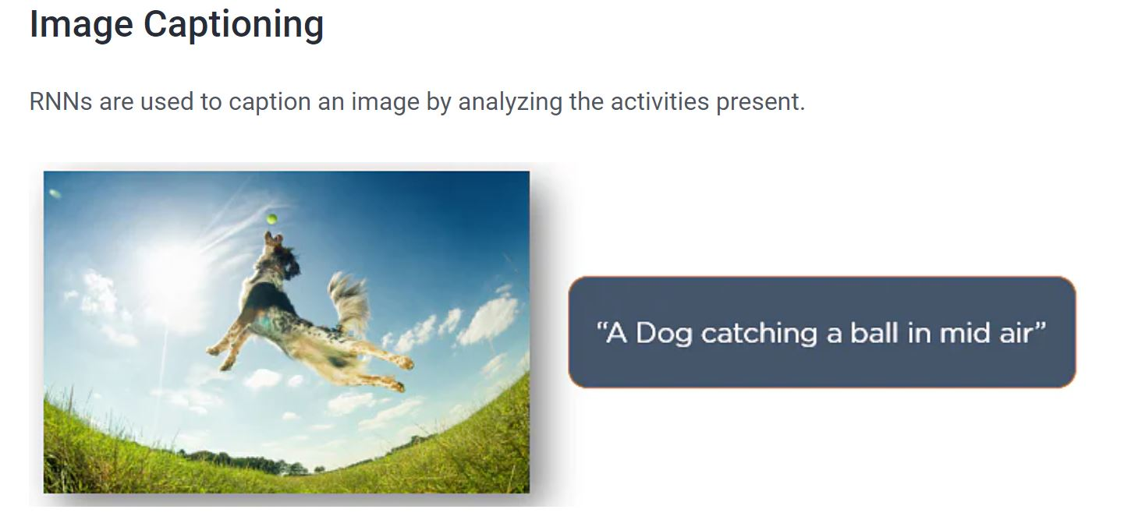
Applications of Recurrent Neural Networks

Slide 11
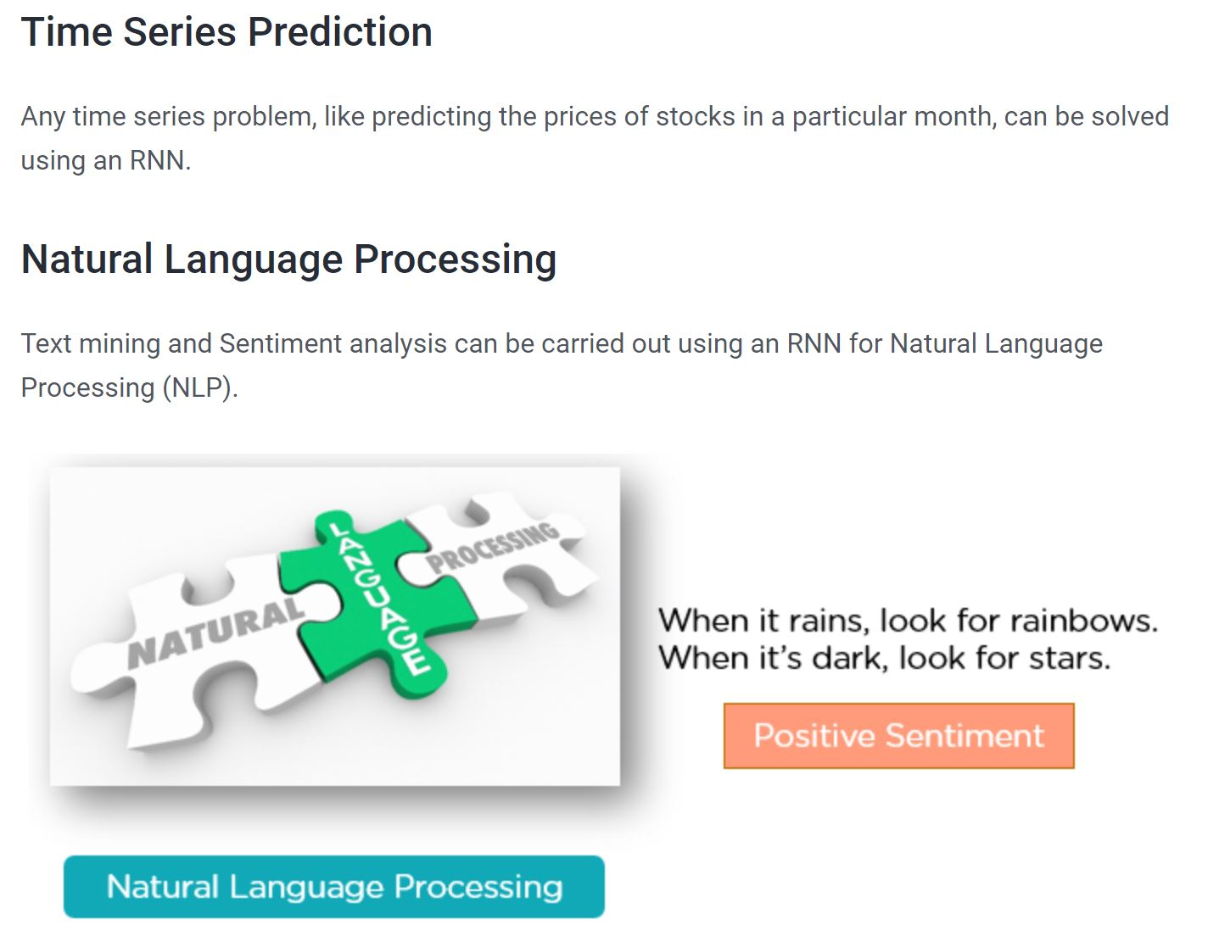

Slide 12


Slide 13
Types of Recurrent Neural Networks
There are four types of Recurrent Neural Networks:
One to One
One to Many
Many to One
Many to Many

Slide 14
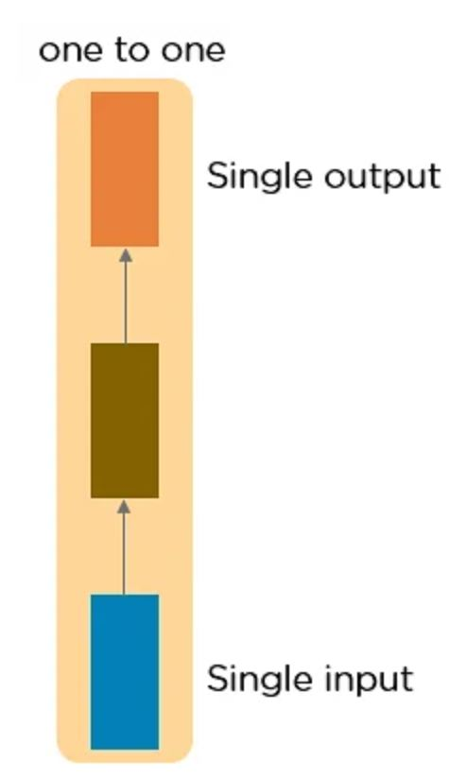
One to One RNN
This type of neural network is known as the Vanilla Neural Network. It's used for general machine learning problems, which has a single input and a single output.

Slide 15
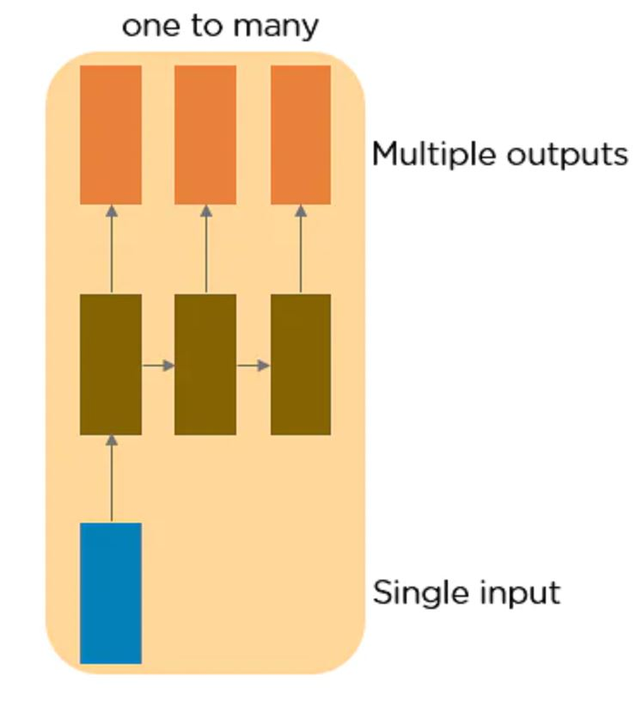
One to Many RNN
This type of neural network has a single input and multiple outputs. An example of this is the image caption.

Slide 16
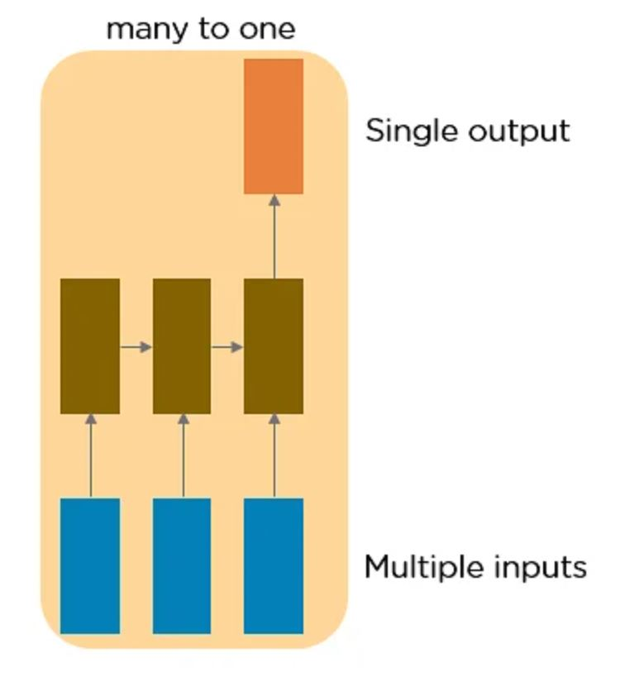
Many to One RNN
This RNN takes a sequence of inputs and generates a single output. Sentiment analysis is a good example of this kind of network where a given sentence can be classified as expressing positive or negative sentiments.

Slide 17
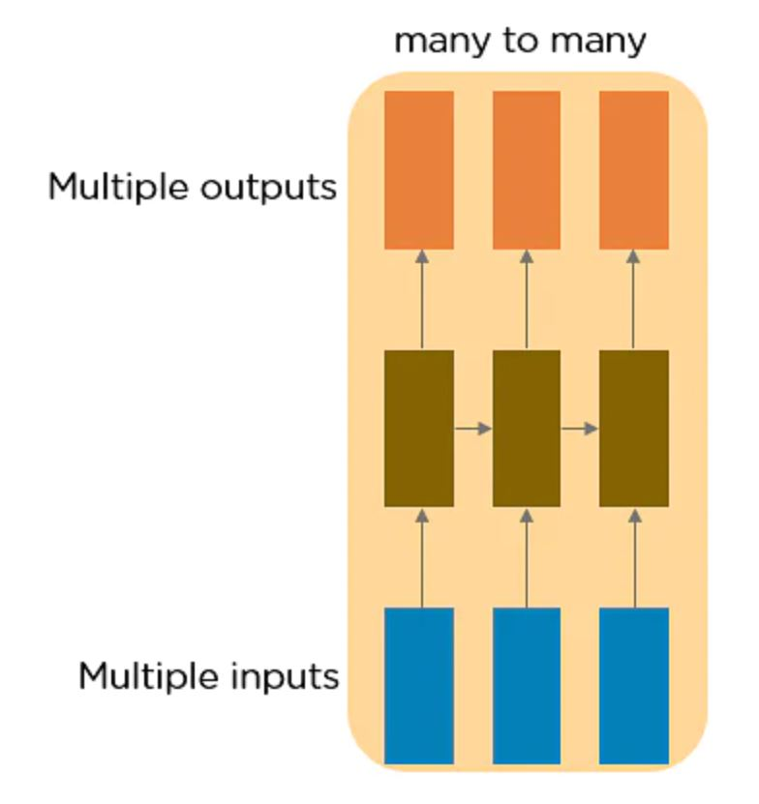
Many to Many RNN
This RNN takes a sequence of inputs and generates a sequence of outputs. Machine translation is one of the examples.

Slide 18
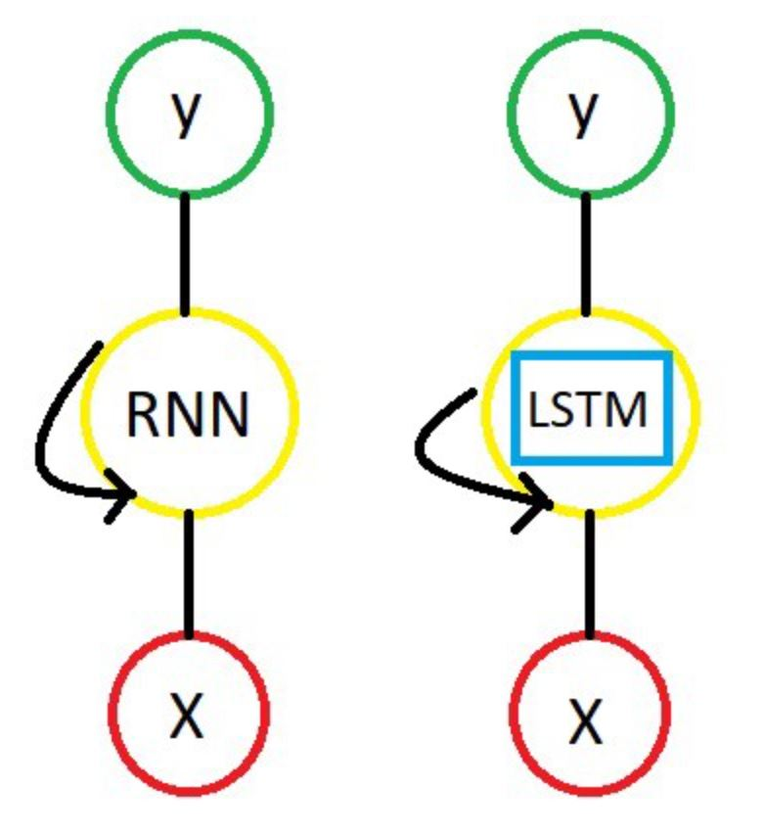
LSTM
Long Short-Term Memory (LSTM) networks are a type of recurrent neural network capable of learning order dependence in sequence prediction problems.
LSTMs are a complex area of deep learning.
Notes:
Vanishing /exploding gradient problem.------ RNN Nearby words.
Today, due to my current job situation and family conditions, need to take a loan.
Memory cell.. Bz this box is containing a short term memory. And long term memory.
We all know that a neural network uses an algorithm called BackPropagation to update the weights of the network.

Slide 19
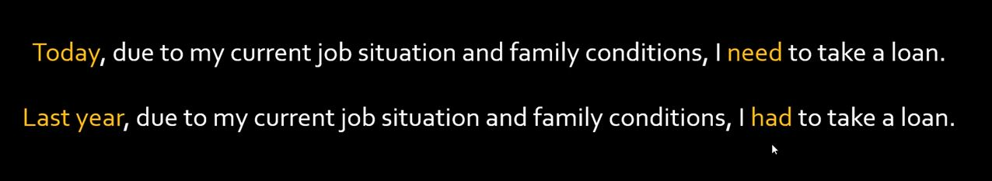
LSTM

Slide 20
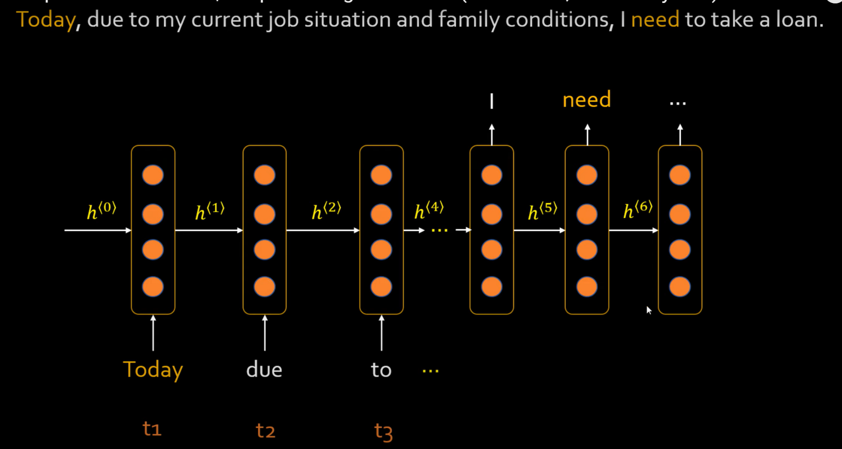

Slide 21
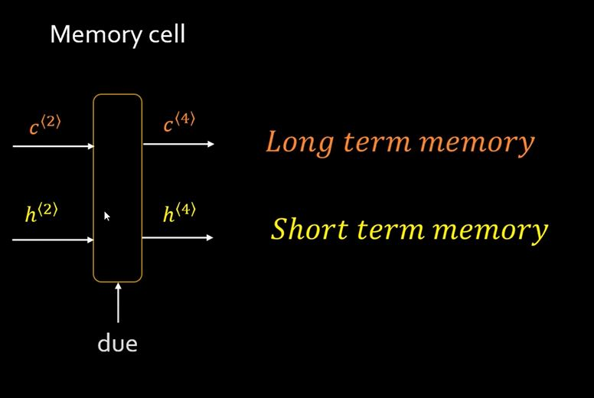

Slide 22
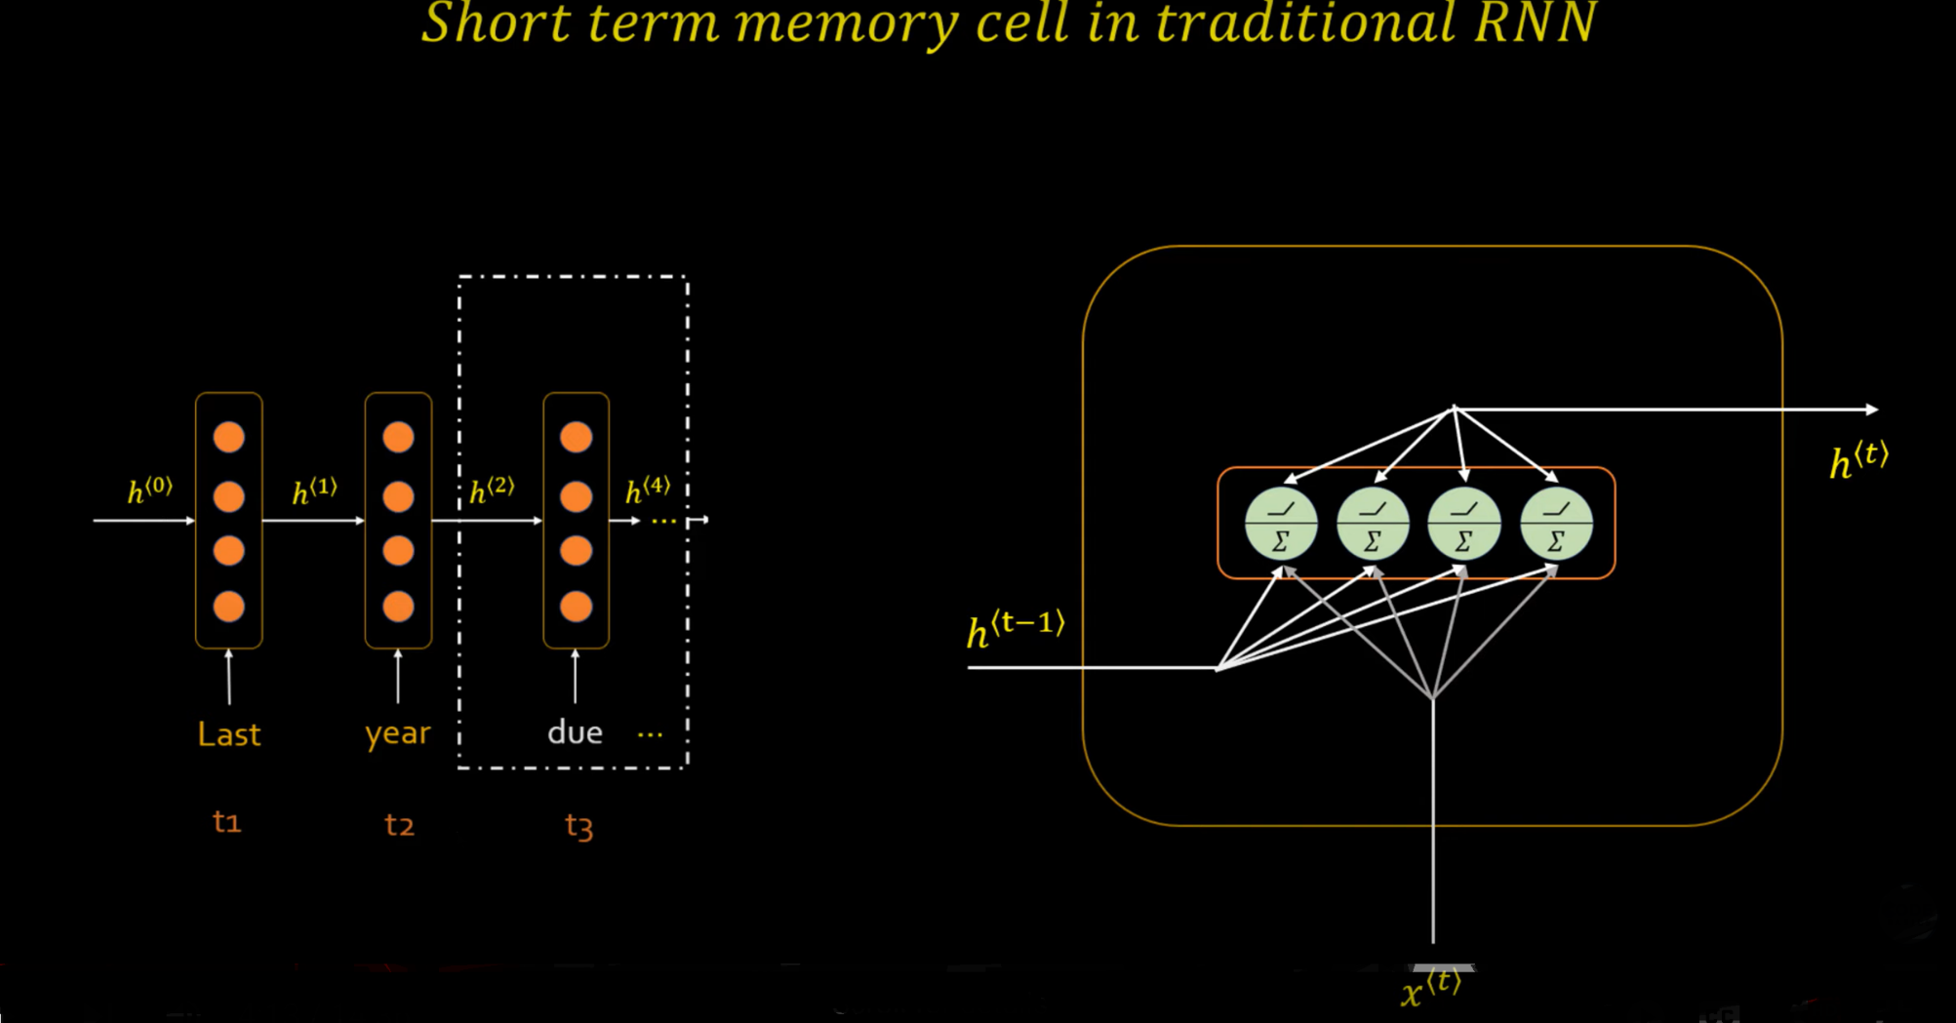
Notes:
Vertical into horizontal

Slide 23
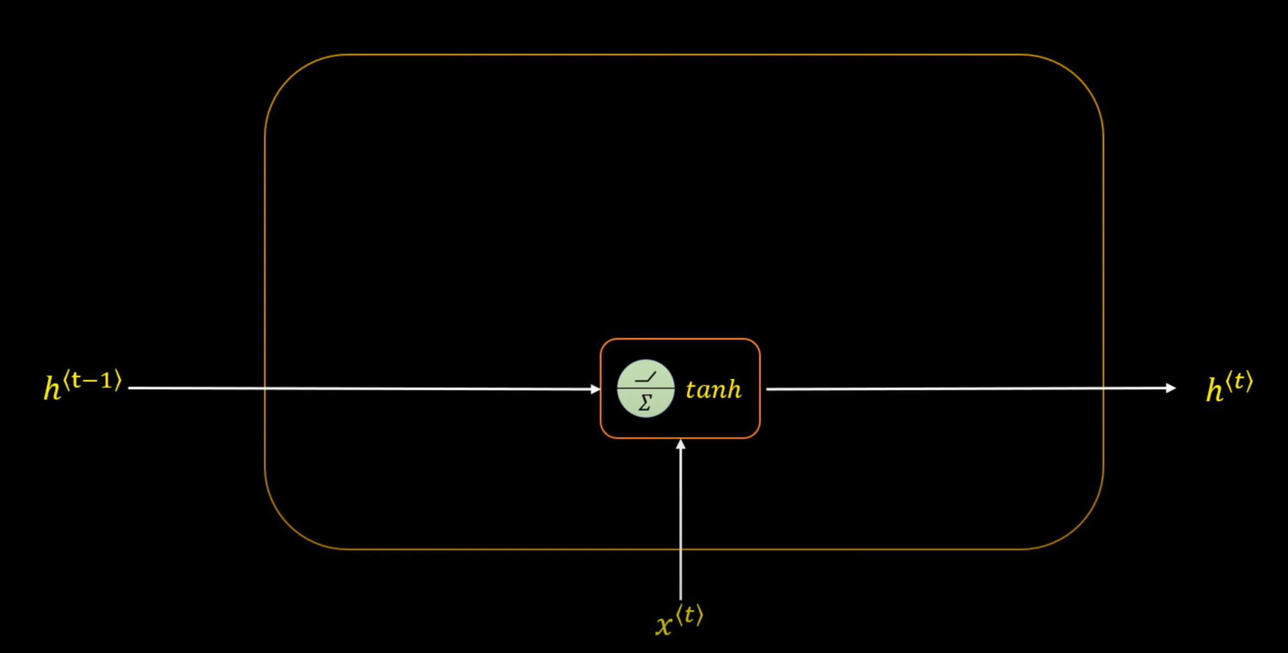

Slide 24
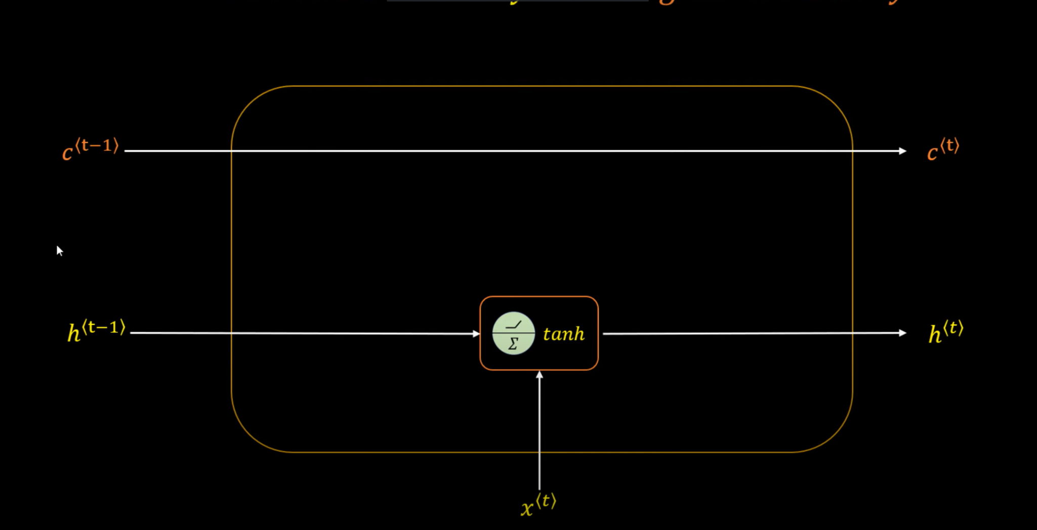

Slide 25
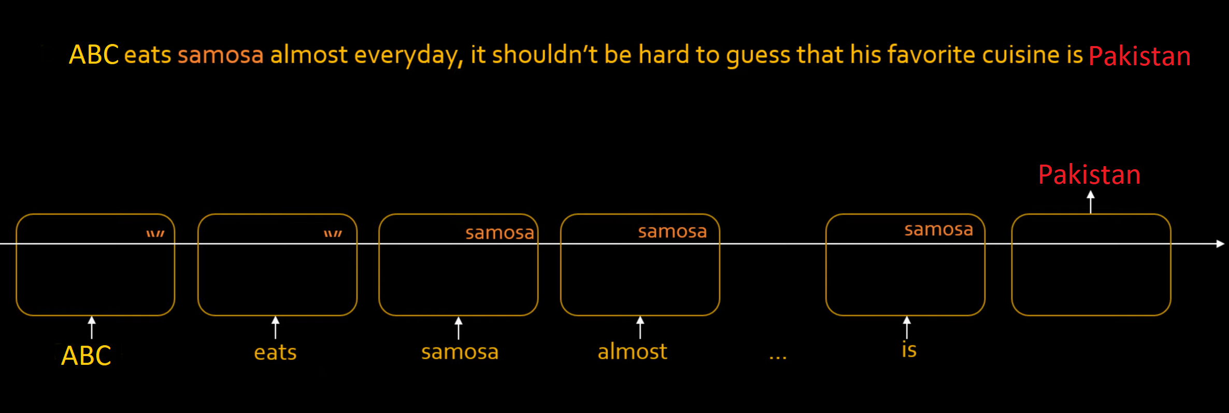
Notes:
Blank String. It will not store in a long term memory. When you find things Samosa.. It will store it in a Long term memory.

Slide 26
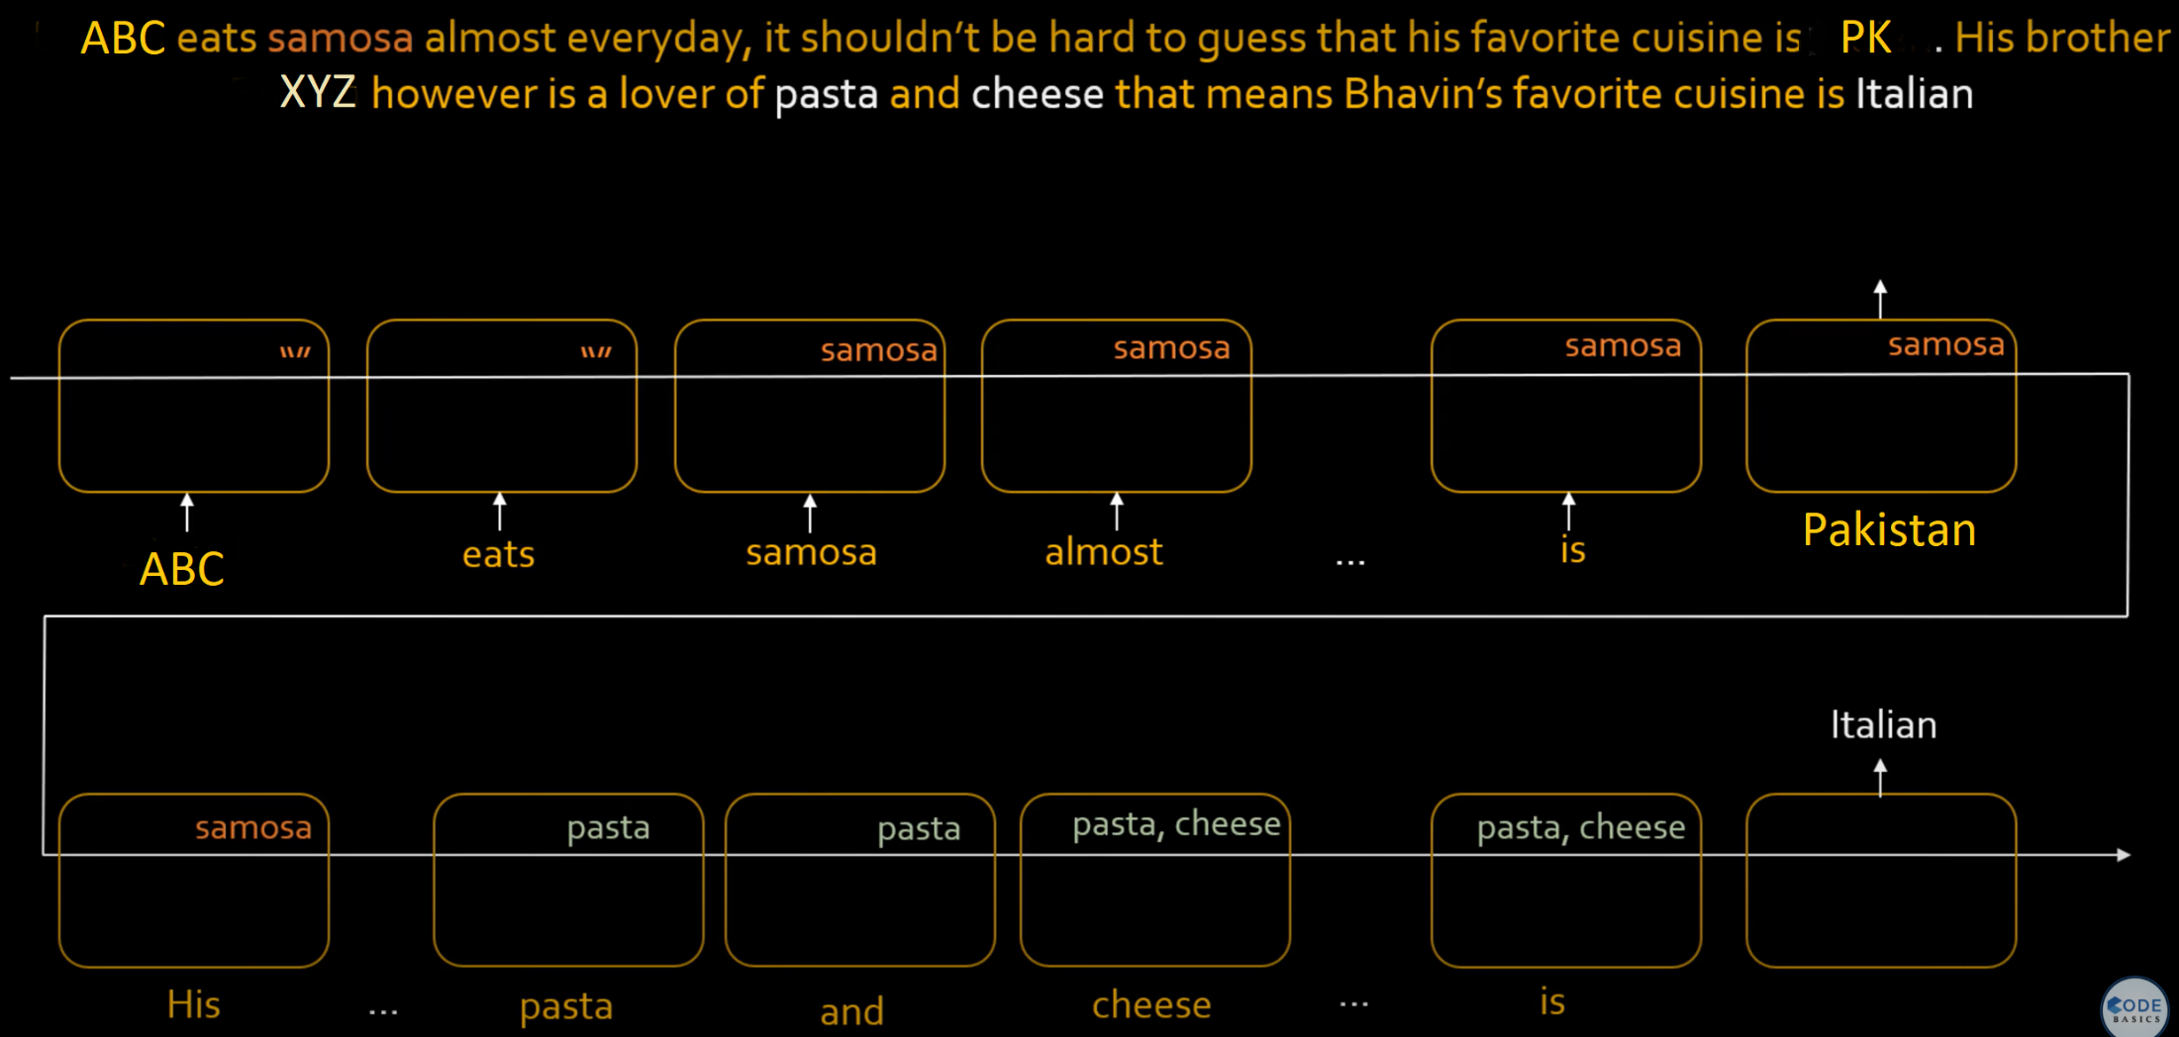
Notes:
Pasta and Cheese add both. Actually, we are going thousand and Thousand of such statements which will build that understanding in out RNN on what to discard and what to store.

Slide 27
Components of LSTM
So the LSTM cell contains the following components.
Forget Gate “f” ( a neural network with sigmoid)
Candidate layer “C`"(a NN with Tanh)
Input Gate “I” ( a NN with sigmoid )
Output Gate “O”( a NN with sigmoid)
Hidden state “H” ( a vector )
Memory state “C” ( a vector)
Notes:
Just like RNN, we have time steps in LSTM but we have extra piece of information which is called “MEMORY” in LSTM cell for every time step.

Slide 28
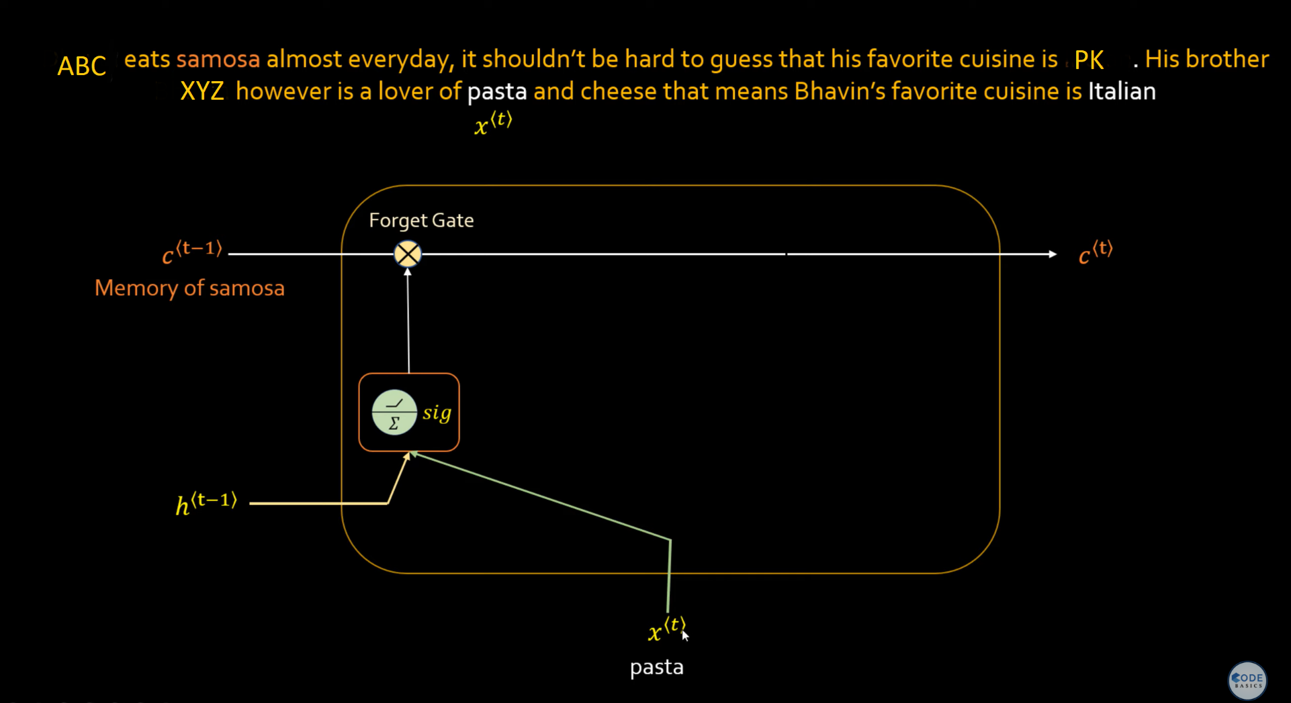
Notes:
Vector--- Weights… We apply Sigmoid function. It restrict your number from 0 to 1.

Slide 29
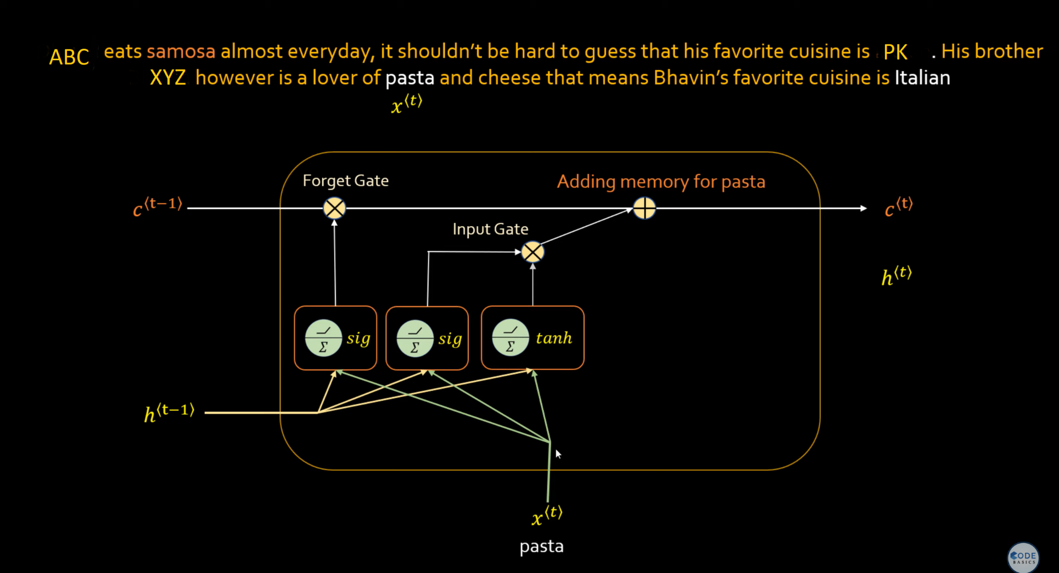
Notes:
Input Gate --- So when Pasta came not only we forgot Samosa, we need to add a memory of pasta so the way it will work is you will sigmoid function/ Tanh (both) on these two vectors.

Slide 30
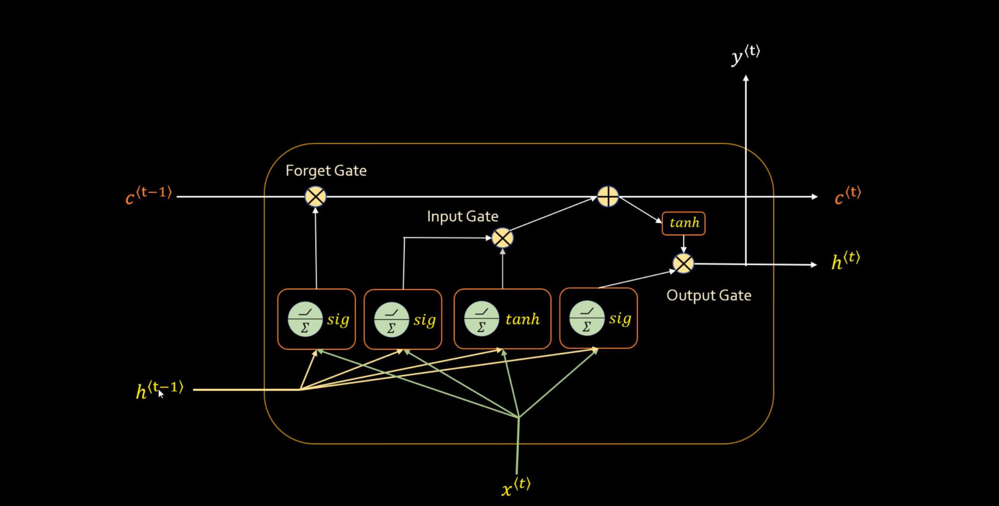
Notes:
Output gate… Name Entity Recognition….. Hidden state,
Long Term memory we have Forget gate and Add Memory gate. --- Meaning full Keywords. Meanings

Slide 31
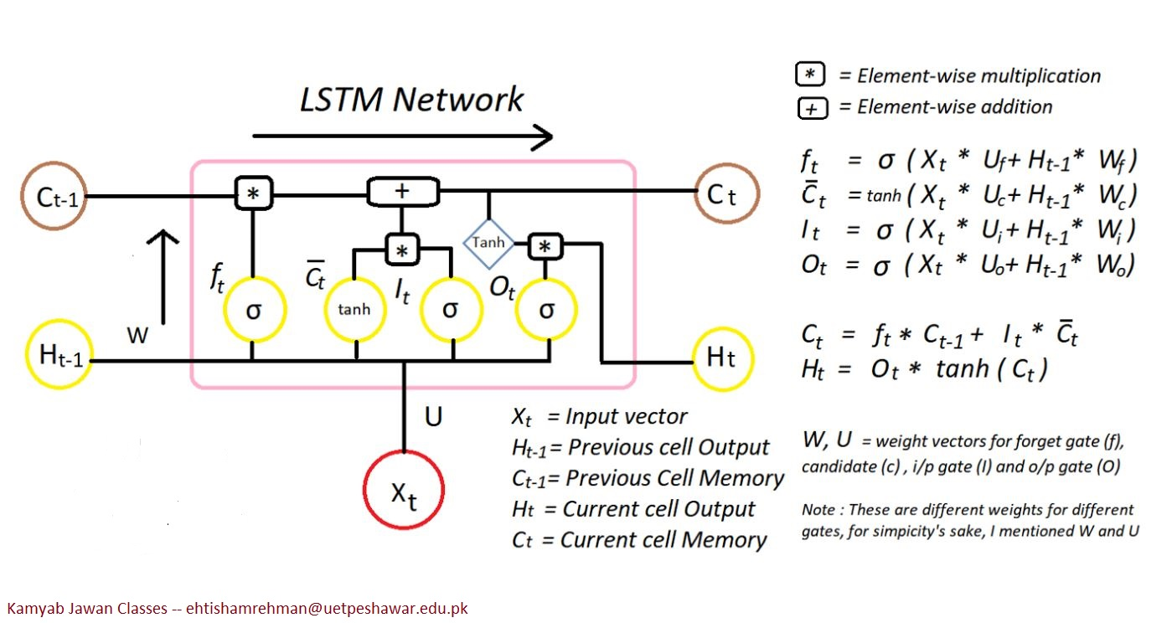
Here is the diagram for a LSTM cell at T time step.
Notes:
How does the LSTM flow work??
If you observe carefully,the above diagram explains it all.
So the LSTM cell contains the following components.
The sigmoid function forms an S shaped graph, which means as x approaches infinity, the probability becomes 1, and as x approaches negative infinity, the probability becomes 0. The model sets a threshold that decides what range of probability is mapped to which binary variable.
Forget Gate “f” ( a neural network with sigmoid)
Candidate layer “C`"(a NN with Tanh)
Input Gate “I” ( a NN with sigmoid )
Output Gate “O”( a NN with sigmoid)
Hidden state “H” ( a vector )
Memory state “C” ( a vector)

Slide 32
Now let me tell you an important piece called Memory state C
This is the state where the memory (context) of input is stored
Ex : Maddy walks in to the room, Monica also walks in to the room. Maddy Said “hi” to ____??
In order to predict correctly Here it stores “Monica” into memory C.
This state can be modified. I mean LSTM cell can add /remove the information.
Ex : Maddy and Monica walk in to the room together , later Richard walks in to the room. Maddy Said “hi” to ____??
The assumption I am making is memory might change from Monica to Richard.
Notes:
so LSTM cell takes the previous memory state Ct-1 and does element wise multiplication with forget gate (f)

Slide 33
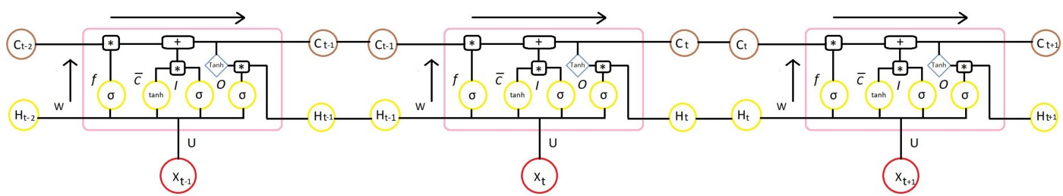
Here is the full diagram for LSTM for different time steps.

Slide 34
Implementation
Python
Google Colab
Seminar on AWS and Cloud Computing on Friday 29, 2022 from 3PM to 5PM.
Notes:
Amazon Web Serives

